Slide 1
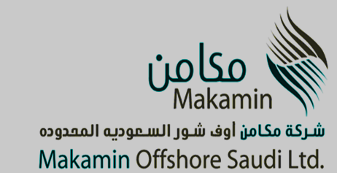

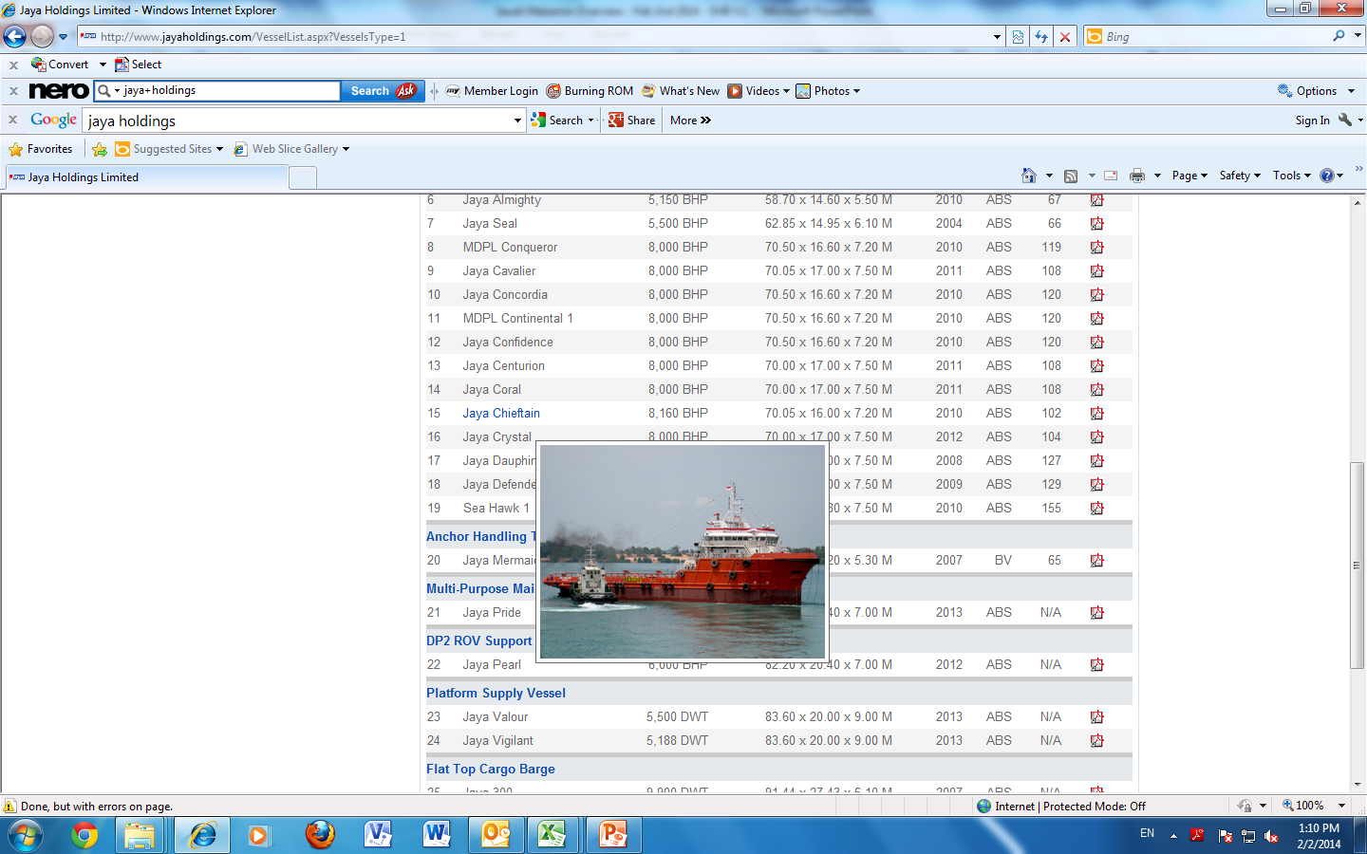
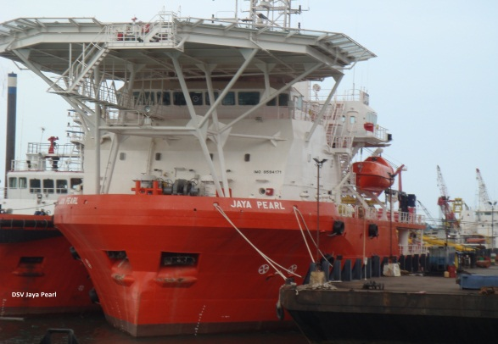
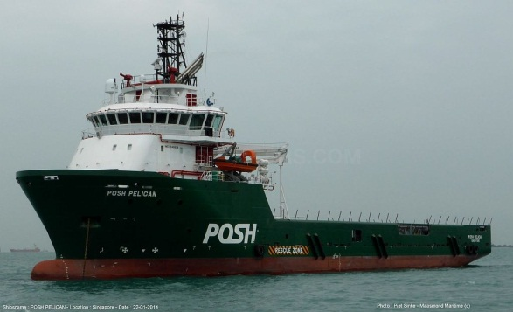
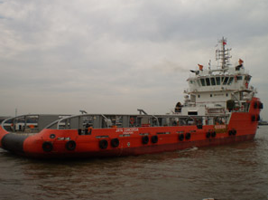
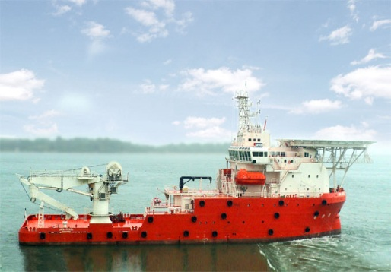
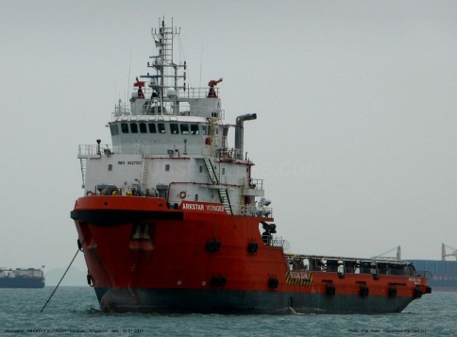
Makamin Offshore
Saudi Ltd.
(MOS)

Slide 2
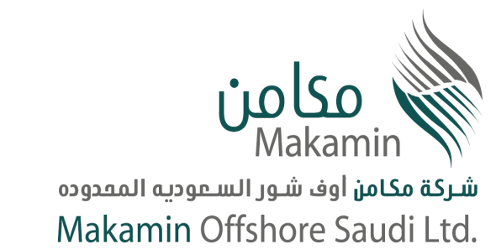
Background:
The Marine sector is strategic, niche and profitable business with Aramco, regionally and internationally which led to starting Makamin Offshore Saudi Ltd. (MOS) in Saudi Arabia.
Competition in the Chartering, Diving, Subsea and Underwater Inspection, Repair and Maintenance (IRM) is limited due to its technical nature and the entry barrier is very challenging.
A Qualification package to approved MOS as a marine services provider was submitted to Saudi Aramco in Summer 2011.
After comprehensive and strict evaluation to our qualification package, Aramco has found MOS technically and financially qualified.
After passing the prequalification phase successfully, MOS started to receive invitations for projects from Saudi Aramco.

Slide 3

Makamin Offshore Organization Structure:

Slide 4
Market Analysis & Forecast:
Increasing Demand for Chartering Services:
Aramco increasing operations to maintain producing over 3M barrels per day from the existing Offshore Fields by increasing offshore drilling Rigs and maintenance of old facilities.
Aramco’s existing fleet is around 210 Vessels and expected to increased to 260 during the next 2 years.
Requirements for new generation of Vessels to meet updated operational standards to replace older vessels.
Replacement of expired contracts with existing more new, larger, and more powerful Vessels with higher fuel efficiency.
Saudi Aramco operational expansion in the Red Sea will require specialized vessel for deep water operations.
Type of Vessels: AHTSS, PSV, Utility, Crew Boats, Docking Tugs, Barges, MSV etc.

Slide 5
Marine Services
Market Analysis & Forecast:
Increasing Demand for Diving Services:
New Technologies for diving services DSV, SAT, ROV etc.
Aramco increasing operations for new facilities and the Inspection, Repair and Maintenance (IRM) requirement of existing and aging subsea facilitates.
Saudi Aramco expansion in the Red Sea with more requirements in saturation diving and ROV services due to deeper waters.
Type of Vessels, Equipment, and Manpower:
Dynamic Positioning Vessels (DPII) capabilities for deeper waters and Conventional Diving Support Vessels (DSV) with Four-Point Mooring for shallower waters.
Air Diving Spreads for less than 50 meters diving requirements and Pressurized Saturations System for more than 50 meters diving requirements.
Remotely Operated Vehicles (Underwater ROVs)
IMCA Certified Air Divers and Saturation Divers with specialized Diving Medics.
Underwater NDT, Inspection, Survey and construction Tools.

Slide 6
Market Analysis & Forecast:
Main Competitors with Aramco:
Competitors:
Zamil Offshore, one of the major player with over 50 vessels but mainly old fleet and need to be replaced as it doesn’t meet the new Aramco requirements and standard.
Hadi Hamma, is an aging family business not focusing on the development and investment to grow their offshore business. However, they are mainly specialized in Crew Boats and small Tugs.
ATCO, owned by Al-Turki family and one of the oldest Marine companies in Saudi Arabia. However with the aging of the owner the new generation have not focused on growing and properly managing the business which led to financial troubles and poor performance. However, they are mainly specialized in Crew Boats and small Tugs.
Al-Mojil is out of the business due to the Group/holding company financial difficulties.

Slide 7
Market Analysis & Forecast:
Main Competitors with Aramco: (Continue)
Tidewater Al-Rushaid, Tidewater is one of the most reputable names in the Marine Industry however Tidewater capability to meet Aramco projects is subject to availability of their own vessels which are in operation worldwide.
Rawabi Swiber, is one of the new comers to the Saudi marine market and has recently been awarded multiple vessels from Aramco during the last three years.
Halul, is a Qatari based company and their mainly focus to support QP marine operations. They have small operations with Aramco.

Slide 8
Market Analysis & Forecast:
Barriers to entry for new comers:
New registration regulations for international companies are now restricted and became difficult setting up new JV companies in Saudi Arabia.
Local companies must have a competent technical JV partner in order to be qualified for Marine Services with Aramco.
Aramco qualification process is increasingly becoming harder and does not allow any international company to work with out going through proper registration and having a local Saudi commercial certification.
For any new company to be able to win projects must need a local infrastructure and financial capability to be competitive.
New government regulations and Saudization will be hard to adapt by new international companies.
Already most international companies are busy all over the world therefore they are not interested to expand in Saudi Arabia provided the complications and investment required for setting up a new local company.
A new company will require 2-4 years to be able to analyze the market, understand Aramco requirements, and to be part of the competition.

Slide 9
Market Analysis & Forecast:
Awarded Contracts:
 | Client | Project | Value (USD) | Duration
1 | Aramco | 5 Platform Support Vessel Charter | 225,000,000.00 | 5 Year
2 | Aramco | Security Accommodation Vessel | 105,000,000.00 | 5 Year
3 | Aramco | Navigational Aids Maintenance Services | 70,000,000.00 | 5 Year
4 | Aramco | THREE (3) INTERCEPTOR VESSELS | 24,000,000.00 | 5 Year

Slide 10
Market Analysis & Forecast:
In Tendering Contracts:
 | Client | Project | Value (USD) | Duration | Status
1 | Aramco | Offshore Manning Services - Tanajib | 75,000,000.00 | 5 Year | Waiting Result
2 | Aramco | Offshore Manning Services - Ras Tanura | 90,000,000.00 | 5 Year | Waiting Result
3 | Aramco | Three (3) Crew / utility / Supply Boats | 85,000,000.00 | 7 Year | Waiting Result
4 | Aramco | OFFSHORE FLOATING STORAGE/SUPPLY VESSEL | 150,000,000.00 | 5 Year | Waiting Result
5 | Aramco | Four (4) Maintenance Boats | 165,000,000.00 | 7 Year | Waiting Result
6 | Aramco | Two (2) Jack up Barges | 450,000,000.00 | 7 Year | Waiting Result
7 | Aramco | Eight (8) AHTSS Vessels | 350,000,000.00 | Shallow Draft 10 Year / Deep Draft 5 Year | Waiting Result
8 | Aramco | Two (2) DP II Maintenance Accommodation Vessels | 190,000,000.00 | 7 Year | Waiting Result
9 | Aramco | One (1) Supply & Trash Collection Vessel | 30,000,000.00 | 5 years | Waiting Result
Total value for in tendering contracts equal to USD 1.585 billion.

Slide 11
Annual Budget 2014 – 2018:
 | BUDGET (Currency SAR “000”)
Description | 2014 | % of TR | 2015 | % of TR | 2016 | % of TR | 2017 | % of TR | 2018 | % of TR
MOS Revenue | 127,000 | 100.0% | 387,954 | 100.0% | 387,954 | 100.0% | 387,954 | 100.0% | 387,954 | 100.0%
Total Revenue (TR) | 127,000 | 100% | 387,954 | 100% | 387,954 | 100% | 387,954 | 100% | 387,954 | 100%
OPERATIONAL COST
TOTAL OPERATIONAL COST | 117,972 | 93% | 307,509 | 79% | 307,551 | 79% | 307,592 | 79% | 307,592 | 79%
GENERAL & ADMIN. COST
TOTAL ADMIN COST | 7,985 | 6% | 17,633 | 5% | 15,761 | 4% | 15,150 | 4% | 14,789 | 4%
Total Cost | 125,958 | 99% | 325,142 | 84% | 323,311 | 83% | 322,742 | 83% | 322,382 | 83%
Other Income | 0 | 0.0% | 0 | 0.0% | 0 | 0.0% | 0 | 0.0% | 0 | 0.0%
Income/Loss Before Tax | 1,042 | 1% | 62,812 | 16% | 64,643 | 17% | 65,212 | 17% | 65,573 | 17%
Provision For Zakat & Tax | 134 | 0.1% | 8,056 | 2.1% | 8,290 | 2.1% | 8,363 | 2.2% | 8,410 | 2.2%
Net Operating Income/Loss | 909 | 1% | 54,756 | 14% | 56,353 | 15% | 56,849 | 15% | 57,163 | 15%

Slide 12
Keys to Success & Risk Management:
leveraging on Solid international marine network.
Competent, dedicated, and professional redundant technical and management team.
Proper Finance Management and contracts review and control.
Full awareness of Aramco’s technical and QHSE requirements and standards.
Monitoring markets and competitors trends.
Providing the client with various solutions that stand out from competitors.
Opening up additional international markets gradually.
Diversification of marine services.
Gearing up for requirements for next generation vessels.
Complying with and following international marine best practices and insurance standards.

Slide 13
Marine Services Today:
As of today, with the technical capabilities and experience of our marine team and associates, the Marine Services has made remarkable achievements being approved and qualified for Diving, Chartering, and other Marine Services for Aramco, becoming among the few in the region who are specialized in such services. Through this achievement Makamin became one of few Contractors recognized in Saudi Arabia and with Aramco for Marine operations.
Now Makamin is providing various specialized services to Aramco via more than 12 Vessels. These projects are valued at more than USD 400M, and we expect to be invited for similar value of projects by Aramco due to its increased Offshore and Marine operations in the Gulf and the Red Sea.

Slide 14
THANK YOU
Makamin Offshore Saudi Ltd.

